Slide 1

PROJECT NAME:
NAME:P DIVYA
REG NO:22AJ1A4465

Slide 2
ONLINE CODE EDITOR
NAME:P.DIVYA
REG NO:22AJ1A4465
BRANCH:CSD

Slide 3
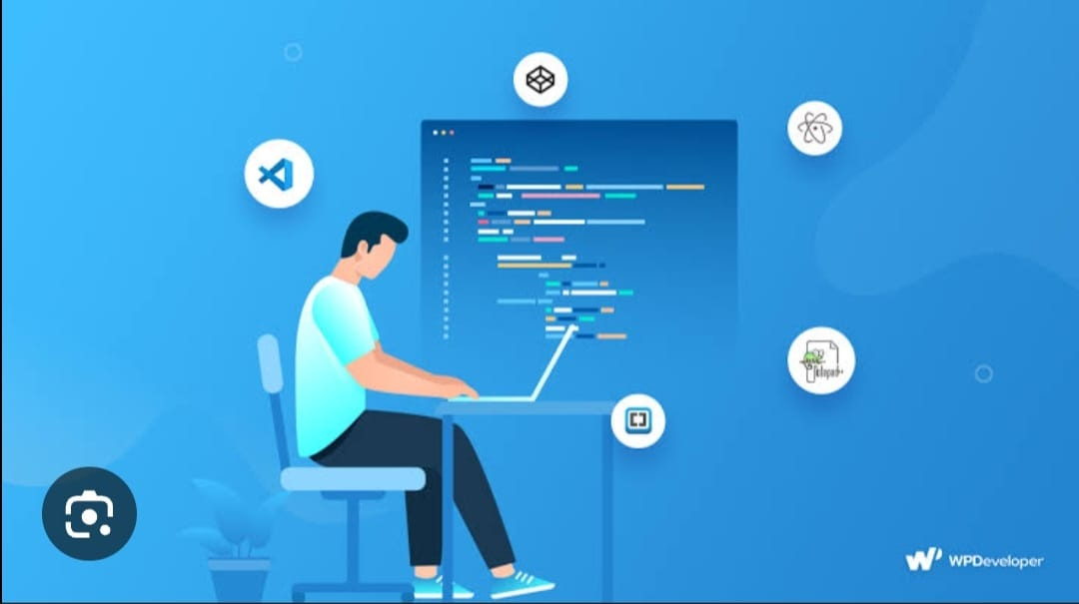
ABSTRACT:
1. *Fundamental Analysis:* Examines company financials, management, industry trends, and economic indicators.
2. *Technical Analysis:* Studies charts, patterns, and market psychology to predict future movements.
3. *Quantitative Models:* Employs mathematical algorithms, machine learning, and data analysis to identify patterns and trends.
4. *Sentiment Analysis:* Analyzes market sentiment, news, and social media to gauge investor attitudes.

Slide 4
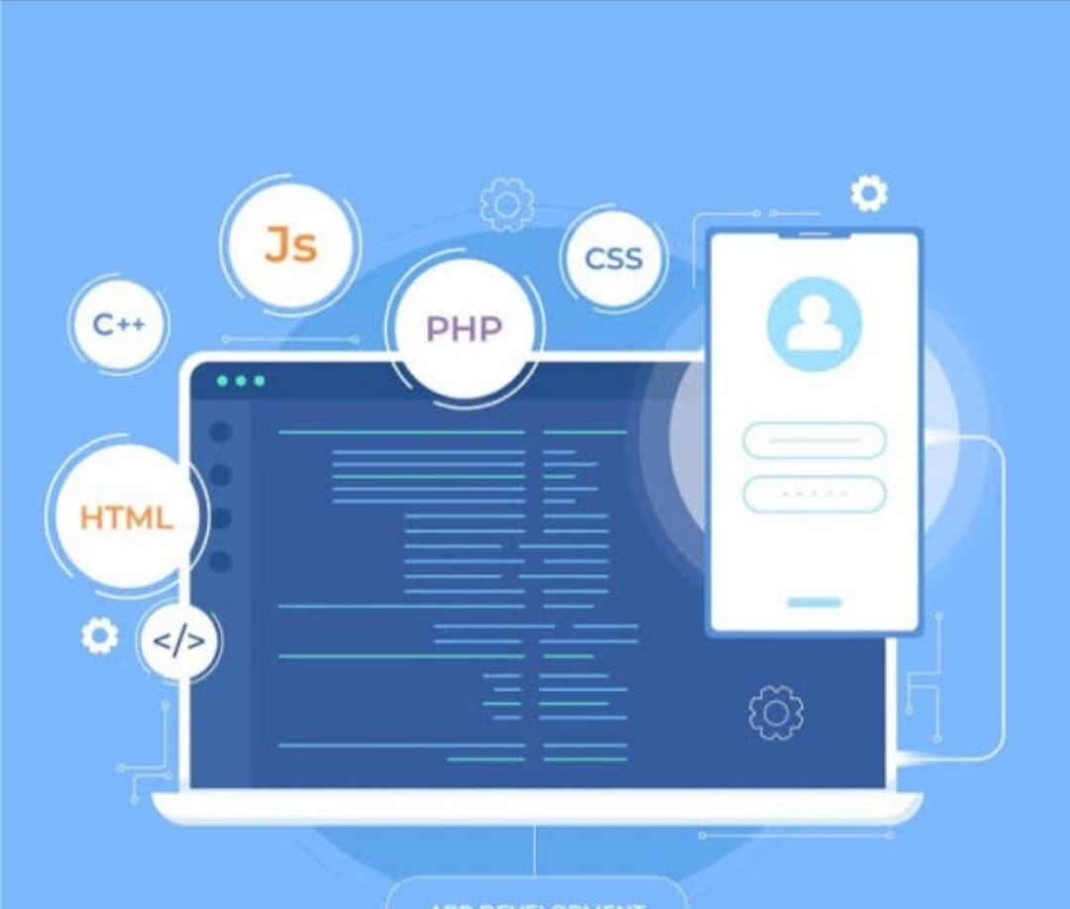
EXISTING SYSTEM:
Stock Market Web App:
Overview: Stock market web app is an web application It supports Python, Flask, and Bootstrap, allowing users to buy stocks in online
Features: Real-time preview, live trading , community engagement, and integration with various libraries and frameworks.
Limitations: Limited backend support, which can restrict micro development and the ability to handle web side.

Slide 5
PROPOSED SYSTEM
PROPOSED SYSTEM:
The proposed stock trading simulation app aims to provide users with an immersive and comprehensive experience in stock market trading, leveraging real-time data to enhance learning and strategy development. The key features and improvements include:
Real-Time Market Data
Unlike existing simulators that may use delayed or static data, our app will utilize real-time market data, allowing users to experience trading conditions as they occur in the live market.
Multi-Asset Support
The app will support a wide range of assets, including stocks, ETFs, options, and cryptocurrencies, enabling users to diversify their portfolios and explore various trading strategies.
Advanced Trading Tools
Users will have access to sophisticated trading tools such as technical analysis charts, risk assessment calculators, and customizable indicators, empowering them to make informed trading decisions

Slide 6
SOFTWARE REQUIREMENTS
. HTML/CSS
Utilized for structuring and styling the user interface of the stock trading simulation app, ensuring a clean and organized layout that enhances user experience.
Bootstrap
Leveraged for responsive design, Bootstrap allows the app to be visually appealing and accessible on various devices, providing a consistent user experience across different screen sizes.
JavaScript
Implemented to add interactivity and facilitate real-time updates, enabling users to engage dynamically with market data and trading features. JavaScript will enhance user interaction with various components, such as charts and trade buttons.

Slide 7
HARDWARE REQUIREMENTS:
Server Specifications:
Processor: Multi-core processors (e.g., Intel Xeon or AMD EPYC) for handling multiple concurrent users.
Memory: Minimum 16GB RAM, scalable based on user load and application complexity.
Storage: SSDs with sufficient capacity to store user data, code snippets, and application logs.
Network: High-speed internet connectivity with load balancing and failover capabilities to ensure uptime and reliability.

Slide 8
ADVANTAGES
Advantages:
Learning Opportunity:
Full-Stack Development: You’ll gain experience in both front-end and back-end development.
Understanding Web Technologies: Working with APIs, databases, and frameworks enhances your tech stack knowledge.
Real-Time Collaboration:
Multi-User Functionality: Implementing features for multiple users can teach you about WebSockets and real-time data handling.

Slide 9
CONCLUSION
The proposed stock trading simulation web app represents a significant advancement in how users engage with the financial markets. By offering a comprehensive, integrated environment that simulates real trading experiences, the app empowers users to enhance their trading skills and strategies in a safe, interactive setting.
With features like real-time market data, multi-asset support, and interactive learning resources, this app addresses the limitations of current simulators and promotes a deeper understanding of market dynamics. The focus on user experience, alongside robust analytics and community engagement, ensures that both individual traders and teams can benefit from the platform.

Slide 10
THANK YOU

